Slide 1
Focus on the Plunder
and the Root of Racial Wealth Inequality

Slide 2
In the last recession, Black and Latinx households had 48% and 36% of their wealth vanish, compared to 24% for white households
The financial crisis wiped out almost $8 trillion in household stock market wealth and $6 trillion in home value.

Slide 3
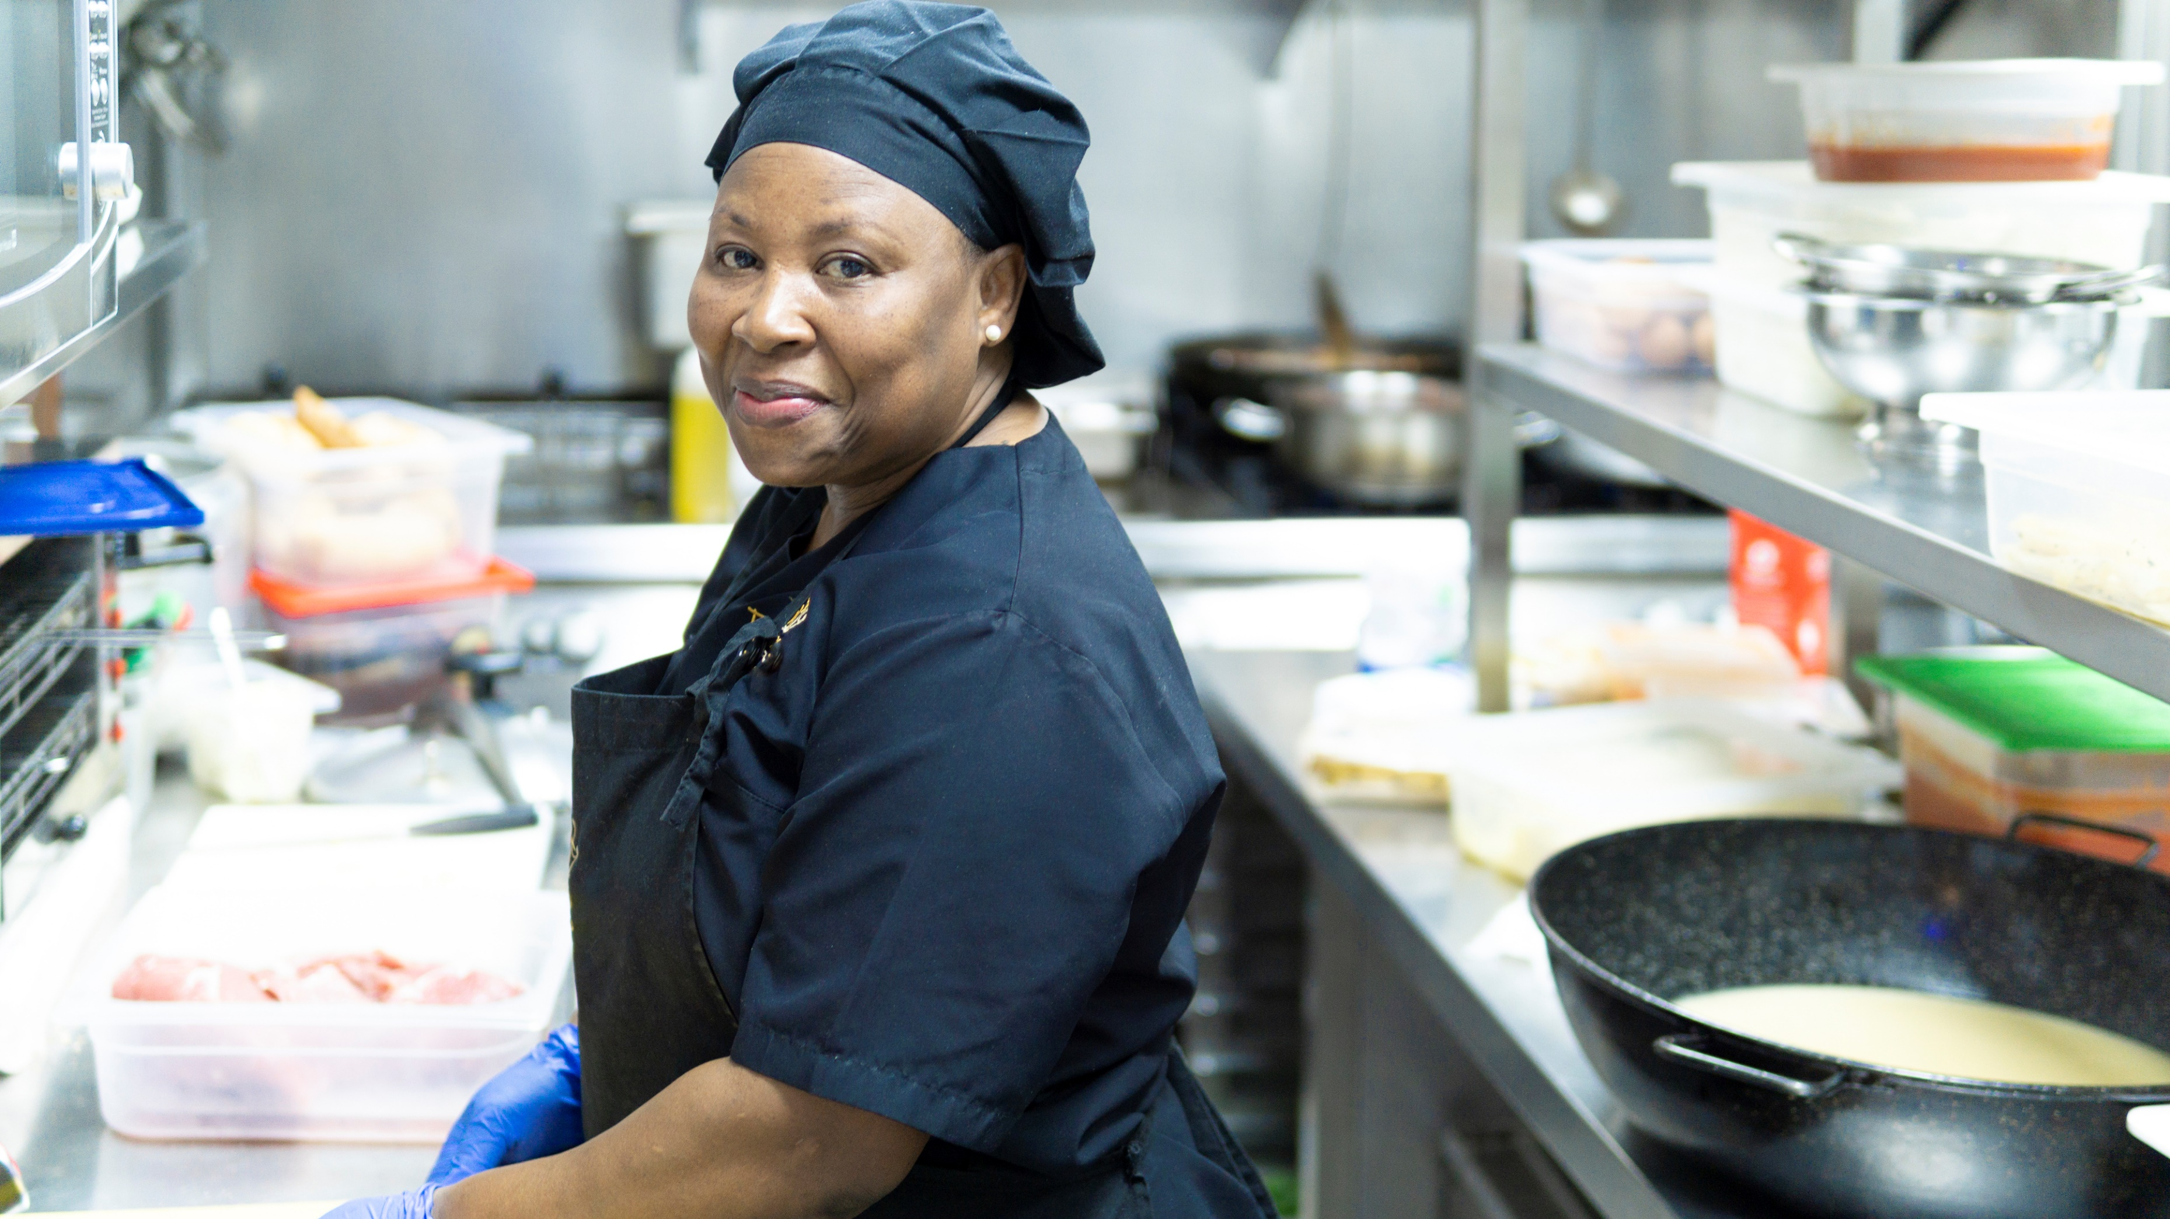
Median Liquid Assets of Households in Los Angeles
Some households have virtually no wealth to draw upon in times of financial crisis
Korean $3,000
Vietnamese $500
Black $200
Mexican $0
South Indian $245,000
Chinese $130,000
White $110,000
Filipino $80,000
Source: Color of Wealth in Los Angeles

Slide 4
Economic Legacy of Inequity
County | Median Income | White Households | Asian Households | Black Households | Latinx Households
Alameda County | $79,831 | $95,331 | $101,544 | $42,642 | $60,819
Contra Costa County | $82,881 | $96,220 | $102,276 | $52,917 | $61,038
Marin County | $100,310 | $109,205 | $92,136 | $57,626 | $53,106
Napa County | $74,609 | $80,840 | $105,168 | $71,701 | $58,849
San Francisco County | $87,701 | $111,704 | $75,013 | $28,603 | $62,153
San Mateo County | $98,546 | $112,359 | $112,148 | $54,964 | $64,707
Santa Clara County | $101,173 | $111,307 | $121,383 | $66,429 | $64,434
Solano County | $69,227 | $75,478 | $85,712 | $53,465 | $58,273
Sonoma County | $73,929 | $71,542 | $72,651 | $58,364 | $52,781
Source: 2016 American Community Survey, U.S. Census Bureau
Notes:
In SF, Whites earn 24,000 more than the median - that difference is basically the median income for Blacks in SF (28K)
Latinx households are really struggling north bay counties - Sonoma and Marin

Slide 5
The Ten Most Common Jobs in San Francisco Metro
Occupation | Number of Positions | Median Wage | Annual Wage
Personal Care Aides | 69,430 | $11.68 | $27,120
Retail Salespersons | 53,780 | $13.34 | $32,530
Cashiers | 47,890 | $12.55 | $28,540
Combined Food Preparation and Serving Workers, Including Fast Food | 47,650 | $12.63 | $27,440
Waiters and Waitresses | 41,540 | $13.93 | $35,410
General and Operations Managers | 41,010 | $63.94 | $157,510
Software Developers, Applications | 40,910 | $64.13 | $141,630
Office Clerks, General | 38,970 | $19.11 | $41,400
Janitors and Cleaners, Except Maids and Housekeeping Cleaners | 37,730 | $14.94 | $35,000
Registered Nurses | 35,480 | $62.15 | $124,970
Source: 2017 Occupational Employment Statistics, Bureau of Labor Statistics
Notes:
Metro area includes: Alameda County, Contra Costa County, San Francisco County, San Mateo County, Marin County
The single most common job in the San Francisco metro area is being a personal care aide, with a median wage of $11.68.
The five most common jobs earn at least $90,000 a year less than the three highest earning jobs on our list. These jobs make up more than 54% of the top ten jobs in the Bay Area.

Slide 6
What role will homeownership play in building wealth going forward?
What will be the cascading effects of job loss on wealth accumulation?
What will be the multigenerational impacts on wealth in communities of color?
How will new narratives, particularly ones built on anti-blackness, influence proposed solutions?

Slide 7
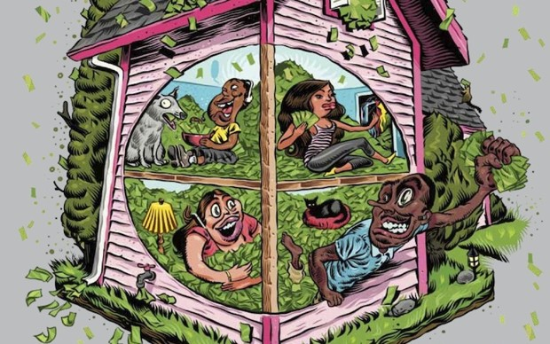

Slide 8
Personhood is deeply tied to work/having a job
Narrative Shift
Deep racial resentment – anti-Blackness
Personal responsibility,
toxic individualism.

Slide 9
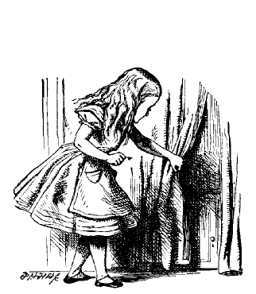
Behind the Curtain: The Creation of Wealth
Exploring and exposing the hidden truths of the racial wealth inequality means pulling back the curtain on how wealth is accumulated

Slide 10
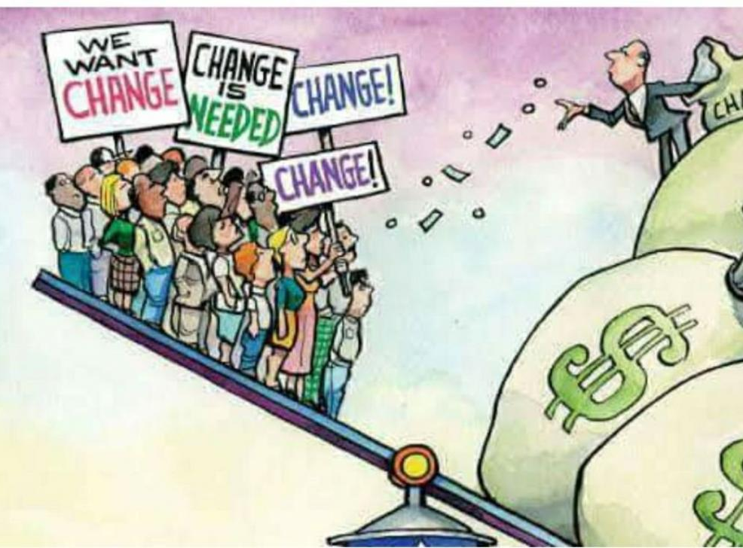
Neoliberal economic policies of the last five decades have cemented racial inequities
Source: Eresh Omar Jamal, The Daily Star

Slide 11
Focus on the plunder to build power
Center work on structural change
Advocate for bold solutions at all levels of government

Slide 12
We Need New Ways of Building Power

Slide 13
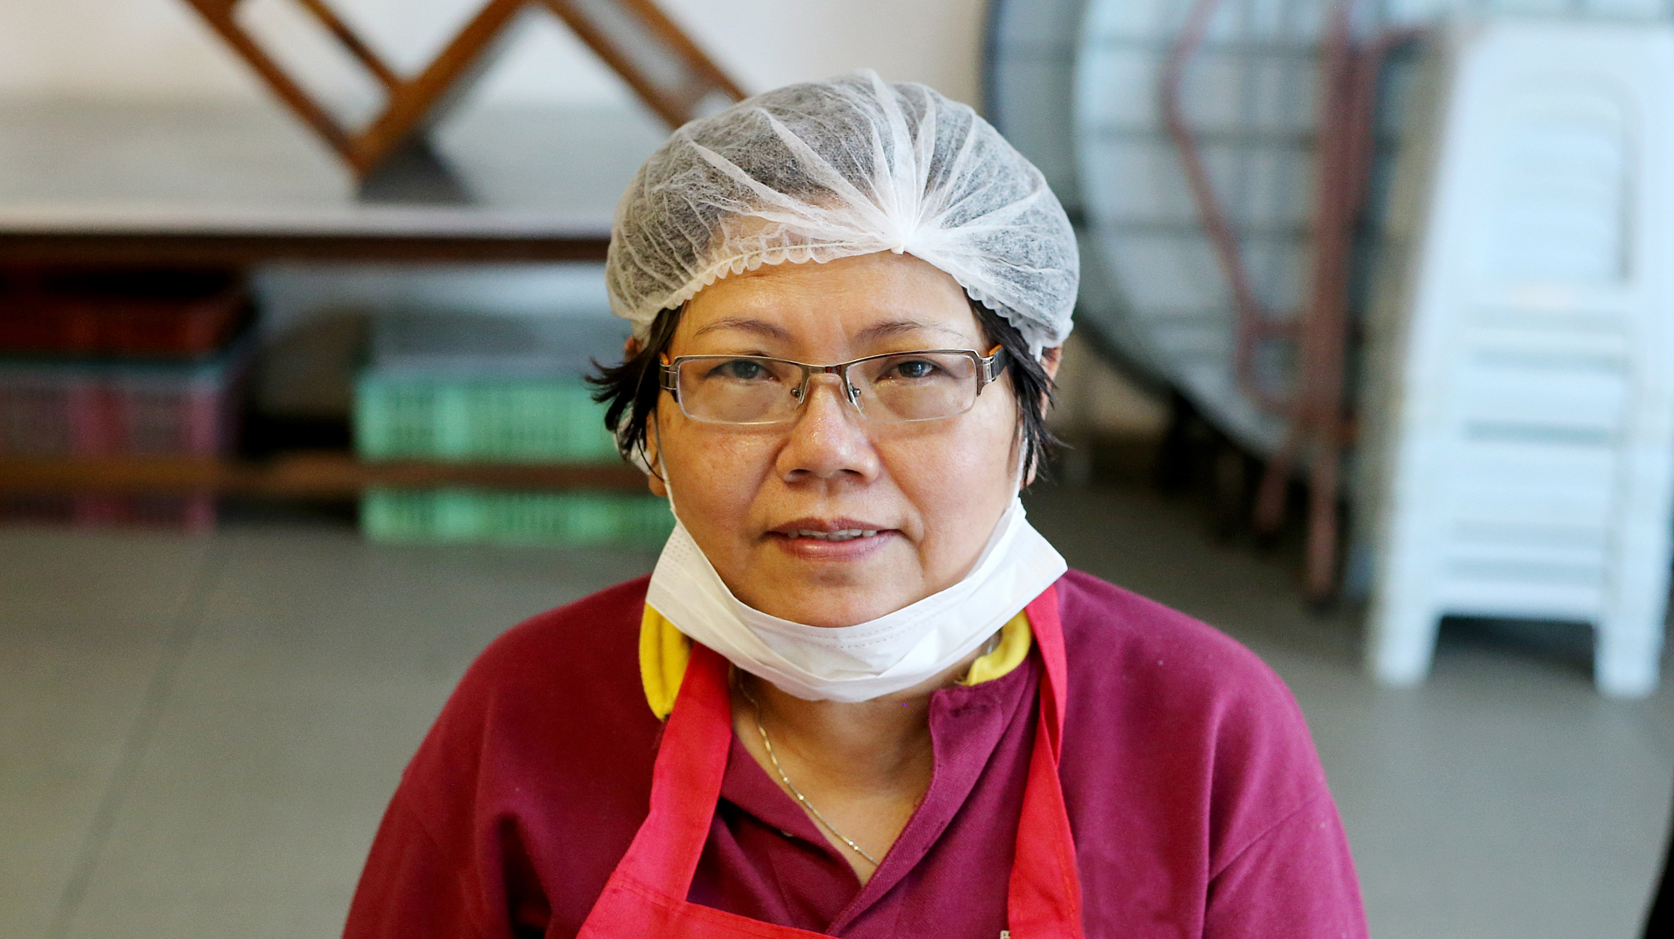
Tackling the Structure of Our Economy, including Corporate Power

Slide 14
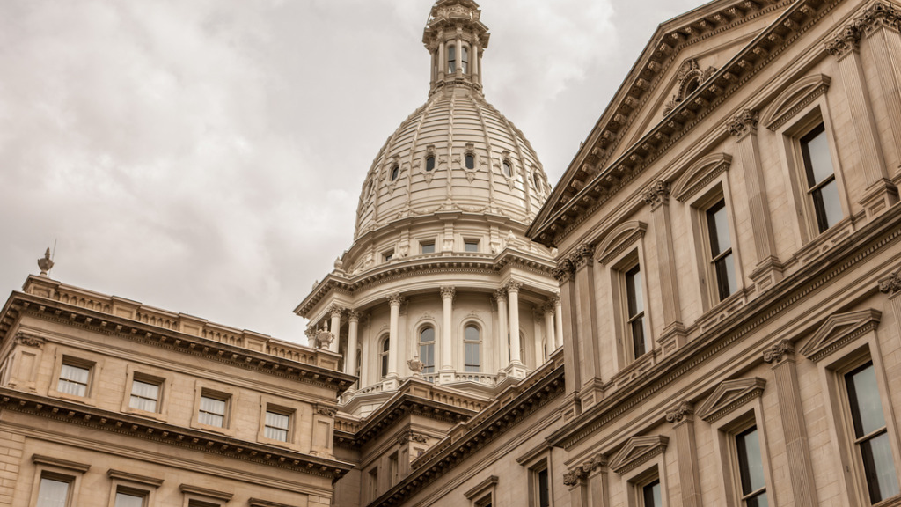
We Must Use Public Power to Curb Private Interests and Provide Universal Public Goods

Slide 15
Connect the Dots Between Wealth, Race and Mass Incarceration

Slide 16
Greater Governance
& Democratization of Capital

Slide 17
THANK YOU!
www.insightcced.org
InsightCCED (@InsightCCED)
Anne Price (@AnnePriceICCED)

